Slide 1

Subscribe to DeepL Pro to edit this document.
Visit www.DeepL.com/pro for more information.

Slide 2

Presentation of CI/CD production adapted to the SUN
Notes:
CI/CD is a proven approach to accelerating software delivery. We've adapted this approach for SUN to improve the quality of our products. Find out how we did it in this presentation.

Slide 3
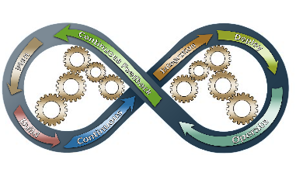
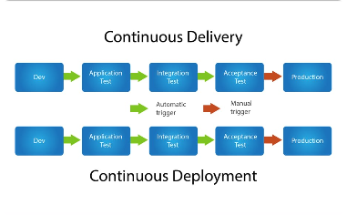
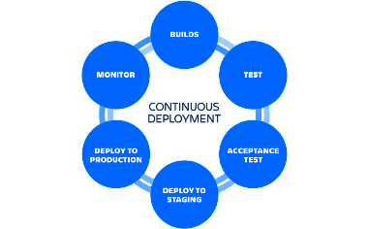
What is CI/CD?
Continuous integration
Continuous delivery
Continuous deployment
Continuous integration allows source code modifications to be integrated into the main branch several times a day. This ensures smoother development and rapid identification of errors.
Continuous delivery makes it possible to deliver stable versions quickly and frequently, thanks to automated testing and deployment.
Continuous deployment automatically pushes validated changes into production. This reduces the risk of errors and increases delivery frequency.

Slide 4
Why adapt it for the SUN company?
Quality
Efficiency
Agility
CI/CD enables us to quickly detect code errors and integration problems, thus improving the quality of our software.
CI/CD speeds up the development and delivery process. As a result, we can deliver higher quality products faster.
CI/CD facilitates rapid resolution of integration issues, enabling us to adapt quickly to changing customer needs.

Slide 5
Presentation of the project for SUN
1
Needs assessment
We began by assessing SUN's specific CI/CD requirements, including the necessary tools and workflows. We identified the key processes that needed to be automated to improve efficiency.
System design
2
We designed a customized CI/CD system for SUN using the best tools on the market. We integrated the tools with existing development and delivery processes.
3
Installation and configuration
We installed and configured the CI/CD system for SUN, seamlessly spanning existing processes. We trained employees to use the new system and worked with them to identify optimal workflows.
Launch
4
We successfully launched the CI/CD system for SUN, achieving immediate results in terms of improved quality, efficiency and process agility. We have continued to fine-tune and improve the system to maximize the benefits for SUN.

Slide 6




Implementation methodology
Brainstorming and Organization
Collaboration
Design and coding
Testing and validation
We organized a brainstorming session to identify the processes that needed to be automated, the tools to be used and the optimal workflows.
We worked closely with SUN employees throughout the process to ensure that workflows were optimal and that the system met SUN's precise needs.
We designed and coded the CI/CD system tailor-made for SUN, using best practices and market tools.
We tested the system thoroughly to ensure quality and stability. We then validated the system using real-life examples from SUN.

Slide 7
Results and benefits
1
Quality improvement
2
Accelerating the development and delivery process
The CI/CD system has considerably improved the quality of the software produced by SUN.
We've seen significant improvements in efficiency thanks to the CI/CD system.
3
Greater adaptability
4
Save time and money
The CI/CD system has enabled SUN to adapt quickly to changing customer needs and growing demands.
The CI/CD system has enabled SUN to cut costs and improve customer satisfaction by producing higher quality software faster.

Slide 8
Questions & Answers

